Slide 1
Efficient communication system for dumb people
Yeshwanth Reddy 19BEC1412
Sai kumar 19BEC1073
Akash Gowda 19BEC1129
Sumit Rawat 19BEC1185
Under the Guidance of Prof. Suchetha M

Slide 2
Motivation
The main motivation behind developing this system is to design a system which can recognize hand movements and gestures and facilates a medium of communication to the people who cannot communicate by talking. These hand movements should be recognized and should be converted into words and provide natural way of communication just like talking. Giving 4-5 instructions to the Gloves and converting those instructions in words are easy but giving the functionality of natural communication similar to talking is very difficult.

Slide 3
Objective
The Primary Objective is to propose a low-cost, more efficient system enable to communicate between normal people and dumb people. By the use hand gestures as a input decode into speech and audio. To take a input by the use of two different sensor for same operation.

Slide 4
Abstract
The mute community around the globe has a hard time communicating with the rest of the world's population. This communication gap is there because a dumb person uses sign language which is not comprehensible by a normal person. This project mainly focuses on removing the barrier of communication between the mute community and the people not familiar with the concept of sign language so that the messages that a dumb person is trying to relay is understandable to a person with no knowledge of sign language. The design of the device is based on embedded systems. Gesture Sensor and Arduino are the key components.

Slide 5
Introduction
A person with speaking disability faces difficulty in communicating with the rest of the population. This device is developed to improve the lifestyle of a person who has speaking disability. This device converts the gesture to speech i.e, gives voice to a mute person. Speech is one of the important factor required for the humans to convey their messages. In this project, Flex sensors play the major role. They are stitched to the gloves. The output from the flex sensors is fed into the Raspberry Pi development board. Arduino converts the analog signal to digital by Using ADC pins and then the data is send to LCD display and gives voice output where the speech output is obtained using an Speaker.

Slide 6
Literature Survey
Safayet Ahmed and Rafiqul Islam [1]: Motivation of this project is to help the speech impaired communities by developing an electronic speaking system. Arduino is main control unit for this system. Arduino was programmed in such way that configuration settings can readily change without changing the entire program code. This electronic speaking system has two way of communication. First one is audio through the speaker and another one is text command that is displayed on the LCD. Gesture is being made with glove consisting of flex sensors. Initially recorded voice commands are saved in the SD card. For specific gesture, there is a particular audio and text command. To increase the audio sound an amplifier was also connected.

Slide 7
Literature Survey
B. G. Lee and S. M. Lee [2]: Gesturing is an instinctive way of communication to present a specific meaning or intent. In this paper, sign language interpretation system using a wearable hand glove is proposed. This wearable system uses five flex-sensors, two pressure sensors, and a three-axis inertial motion sensor to differentiate the characters in the American Sign Language alphabet. The whole system consists of three units: a wearable device with a sensor module, a processing module and a display unit mobile application module. Mobiles that are based on android application were developed with a text-to-voice function that converts the received text into audible output.

Slide 8
Literature Survey
P Vijayalakshmi and M Aarthi [3] The aim behind this work is to develop a system for recognizing the sign language, which provides communication between people with speech impairment and normal people, thereby reducing the communication gap between them. Compared to other gestures (arm, face, head and body), hand gesture plays an important role, as it expresses the user's views in less time. In the current work flex sensor-based gesture recognition module is developed to recognize English alphabets and few words and a Text-to-Speech synthesizer based on HMM is built to convert the corresponding text.

Slide 9
Literature Survey
Jinsu Kunjumon and Rajesh Kannan Megalingam[4] The proposed system will recognize Indian Sign language and convert it into speech and text in 2 languages English and Malayalam and display it on Android phone.

Slide 10
Literature Survey
T. Shanableh[5] for recognizing isolated Arabic sign language gestures in a user independent mode. In this method the signers wore gloves to simplify the process of segmenting out the hands of the signer via colour segmentation. The effectiveness of the proposed user-independent feature extraction scheme was assessed by two different classification techniques; namely, K-NN and polynomial networks. Many researchers utilized special devices to recognize the Sign Language

Slide 11
Literature Survey
Byung - woo min et al.,[6] presented the visual recognition of static gesture or dynamic gesture, in which recognized hand gestures obtained from the visual images on a 2D image plane, without any external devices. Gestures were spotted by a task specific state transition based on natural human articulation

Slide 12
Hardware Requirements

Slide 13

Arduino Uno
The Uno with Cable is a micro-controller board base on the ATmega328. It has 14 digital input/output pins (of which 6 can be used as PWM outputs); 6 analog inputs, a 16 MHz ceramic resonator, a USB connection, a power jack, an ICSP header, and a reset button.
It contains everything need to support the microcontroller; simply connect it to a computer with a USB cable or power it with an AC-to-DC adapter or battery to get started.

Slide 14
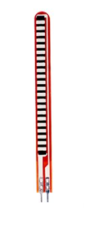
Flex Sensor
A flex sensor or bend sensor is a sensor that measures the amount of deflection or bending. Usually, the sensor is stuck to the surface, and resistance of sensor element is varied by bending the surface. Since the resistance is directly proportional to the amount of bend it is used as goniometer, and often called flexible potentiometer.

Slide 15
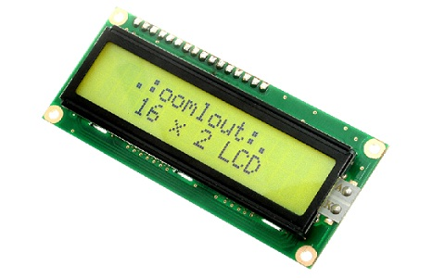
LCD
The term LCD stands for liquid crystal display. It is one kind of electronic display module used in an extensive range of applications like various circuits & devices like mobile phones, calculators, computers, TV sets, etc. These displays are mainly preferred for multi-segment light emitting diode and seven segments. The main benefits of using this module are inexpensive; simply programmable, animations, and there are no limitations for displaying custom characters, special and even animations, etc.

Slide 16
Software Requirements

Slide 17
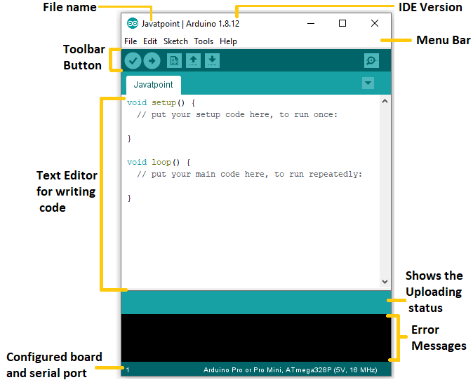
Arduino IDE
The Arduino Integrated Development Environment - or Arduino Software (IDE) - contains a text editor for writing code, a message area, a text console, a toolbar with buttons for common functions and a series of menus. It connects to the Arduino hardware to upload programs and communicate with them.

Slide 18
Existing system
To Two traditional ways of communication between deaf person and hearing individuals who do not know sign language exist through interpreters or text writing. The interpreters are very expensive for daily conversations and their involvement will result in a loss of privacy and independence of a dumb person. Thus, a low-cost, more efficient way of enabling communication between normal person and dumb person is needed.
Drawbacks:
Only writing on notes can convey the messages.
No automatic sensing of gestures.
Uncomfortable to understand if the other person don’t know the Sign Language.

Slide 19
Proposed system
In this proposed system flex sensor is implemented to capture the hand gestures of a user. The flex sensors output a stream of data that varies with degree of bend. This is given to Arduino and it will give output using Speaker.
Here flex sensors are used to detect hand posture. Flex sensors are carbon resistive elements. When the sensor is bent, corresponding to the bend radius it produces the output resistance.
Approximately from 10K to 30K ohm the resistance value is varied. When sensor is bent at 90 degree the resistance increases to 30K ohm and an unfixed sensor resistance is decreased to 10K ohm.
So by using this people can communicate.

Slide 20
Block Diagram
Power Supply
Arduino
LCD
Flex Sensor
Flex Sensor
Flex Sensor
Flex Sensor
APR9600 Module
Speaker

Slide 21
Working
The user wears a glove that has flex sensors on it. Now when the user wants to say something, he/she makes gestures by bending the fingers. So, different combinations are made with the bending of the flex sensors creating different resistance combinations for the output pin of the Arduino to exhibit different entity. Arduino is connected to Voice Module; which is further connected to speaker. The flex sensor will give input to Arduino with the bending of the fingers of the person resulting in the change of the angles of the flex sensor hence changing the resistance will trigger the Arduino to give the relevant output as per the code we have written i.e., which combination of resistances will give which entity as our output. Further, when we will have the output, the speaker which is connected to the Voice module will give the speech signal as our output.

Slide 22
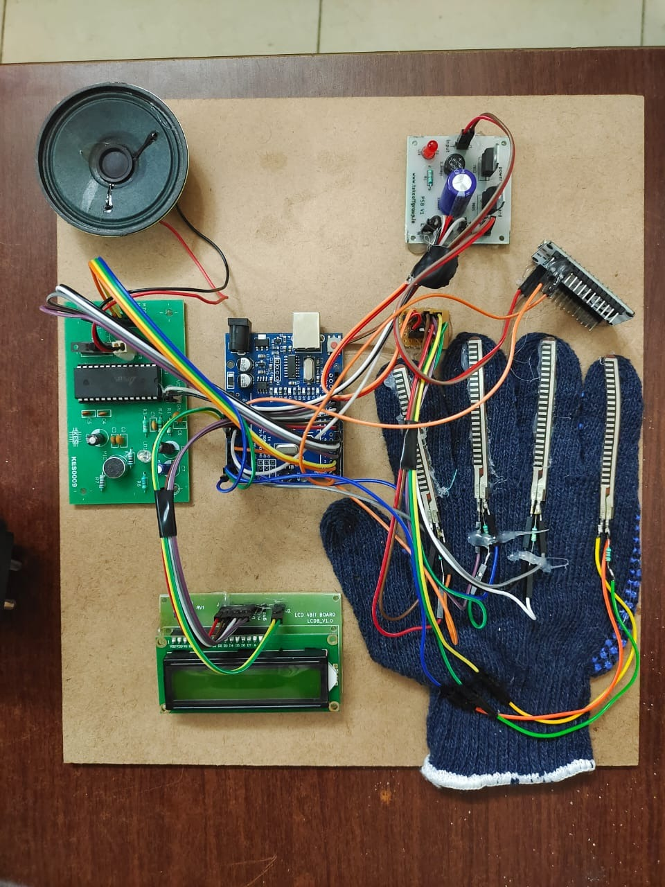
Components and Setup
Flex sensors
Arduino UNO
Voice Module
Power Supply Board
Wifi Module
LCD
Speaker

Slide 23
Threshold Sensor Values
Grocery: 630 <= Flex1 <= 650
Railway station: Flex1 >= 680
Rest room: Flex2 <= 1022
Hospital: 800 <= Flex3 < 840
Pharmacy: Flex3 >= 840
Bus Stop: Flex4 <= 1022
Else normal condition

Slide 24
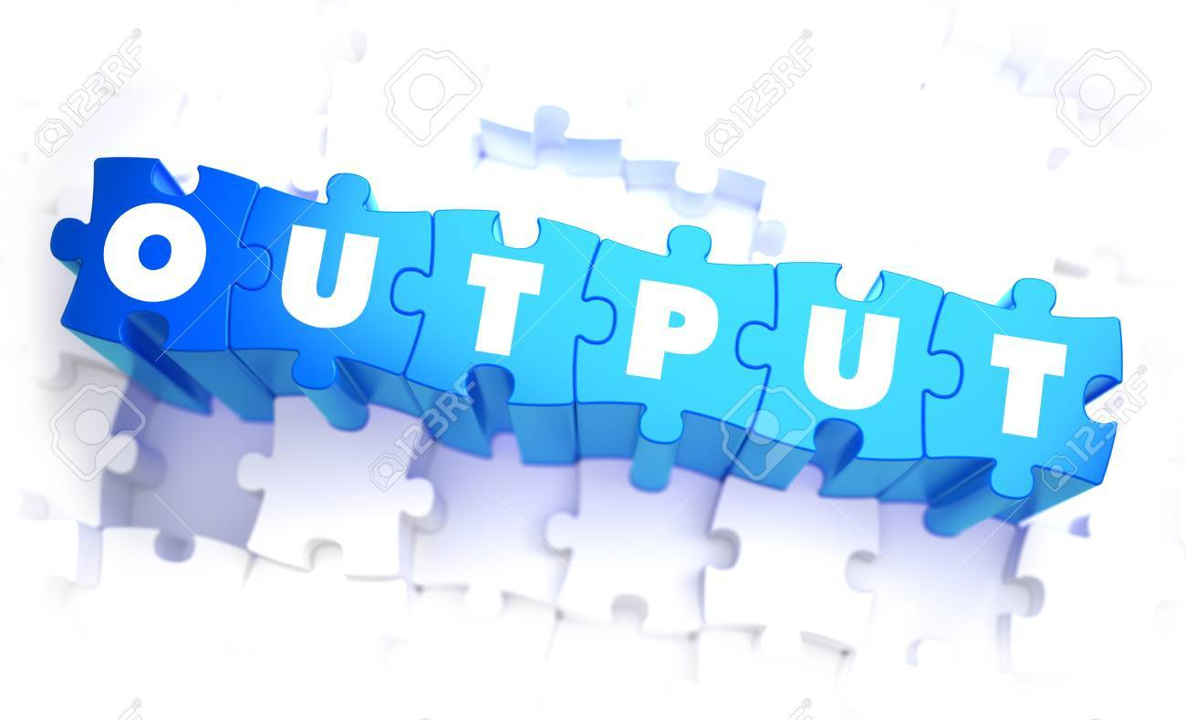

Slide 25
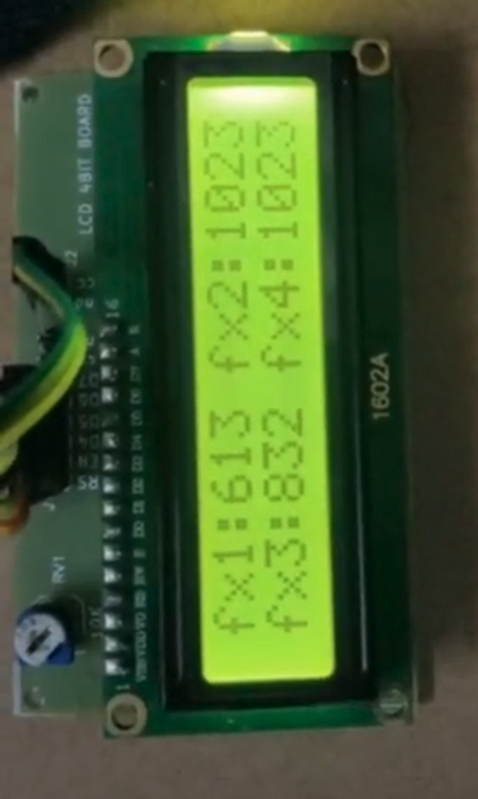
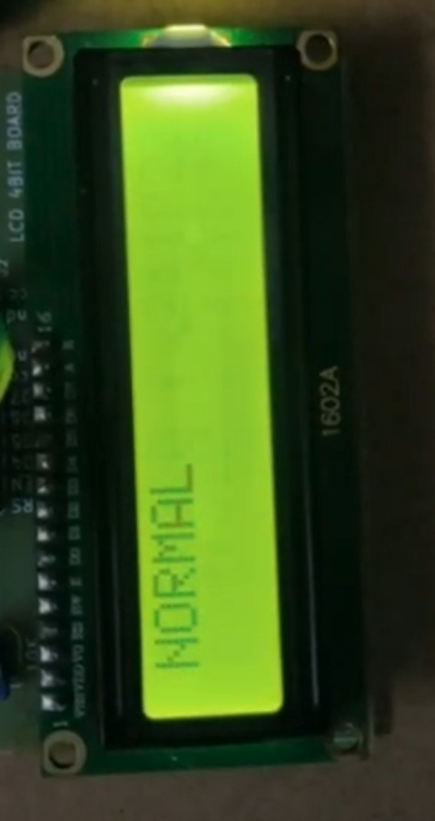
Normal condition

Slide 26
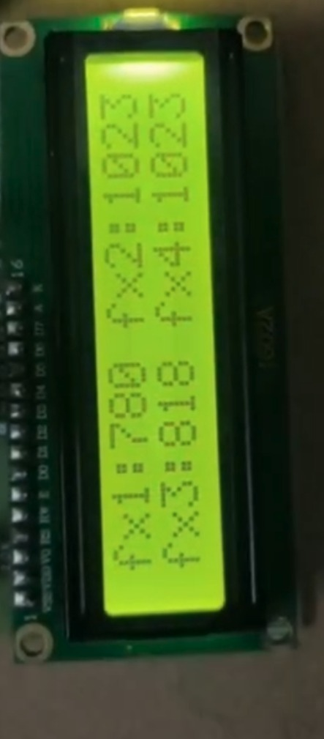
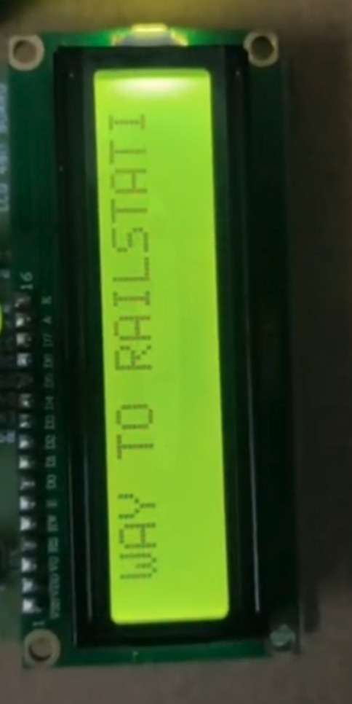
RAILWAY STATION

Slide 27
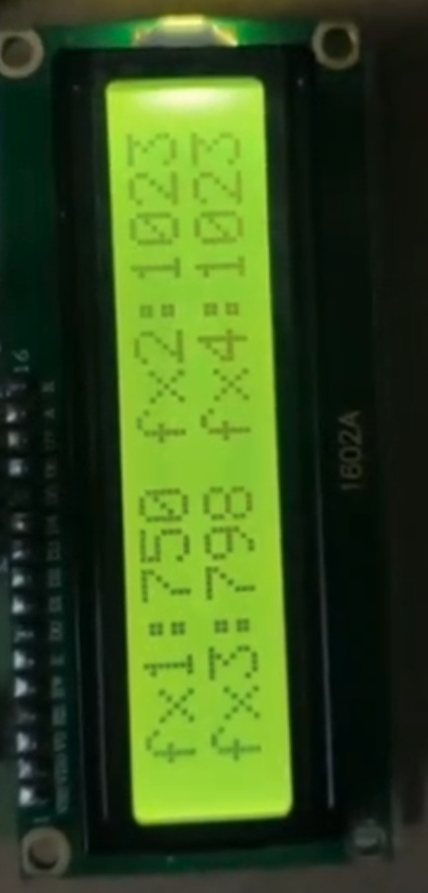
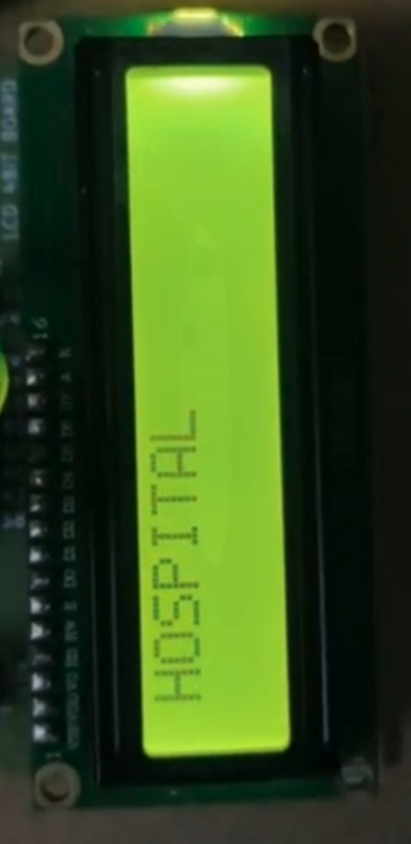
Hospital

Slide 28
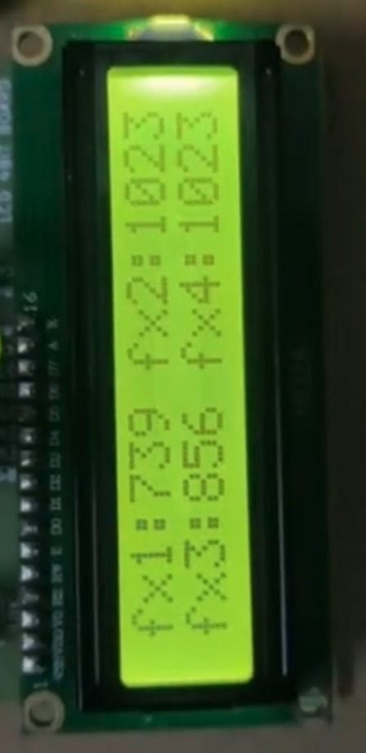
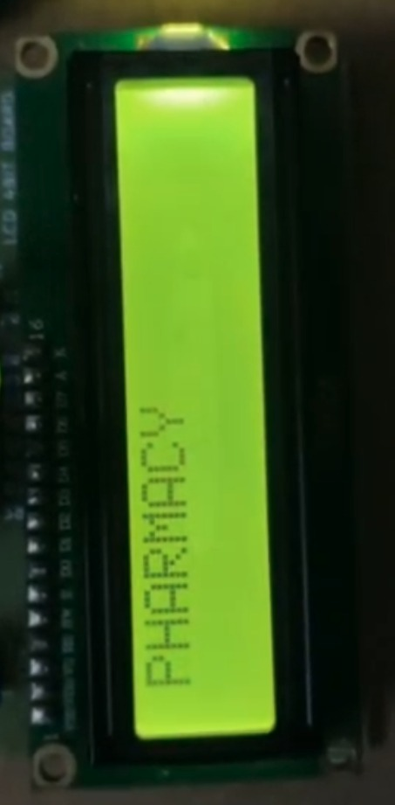
Pharmacy

Slide 29
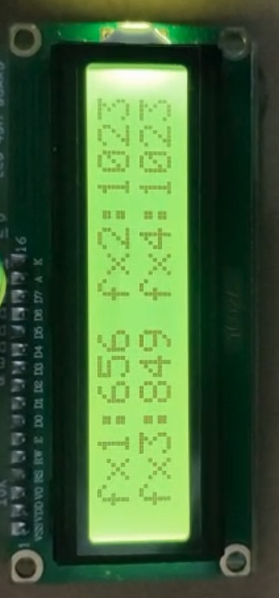
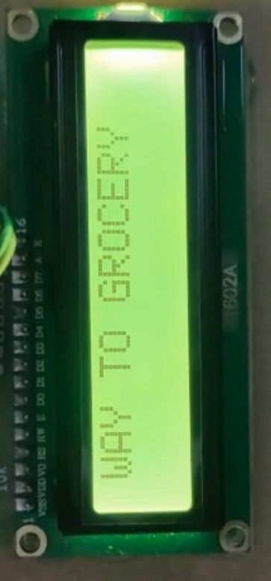
Grocery

Slide 30
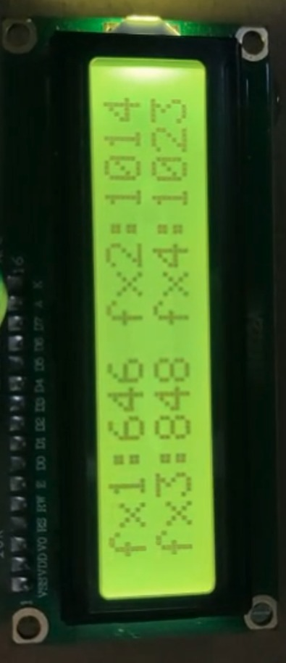
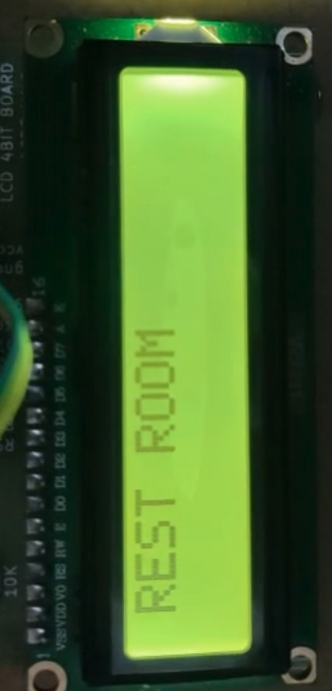
Rest Room

Slide 31
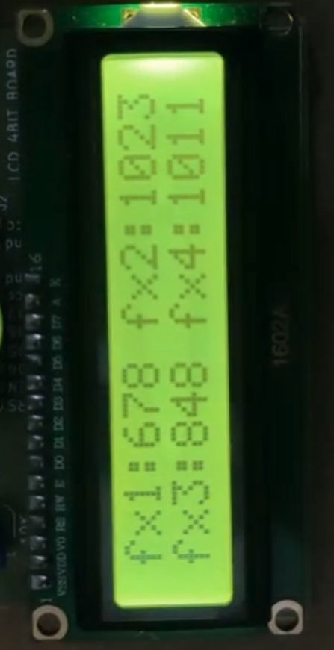
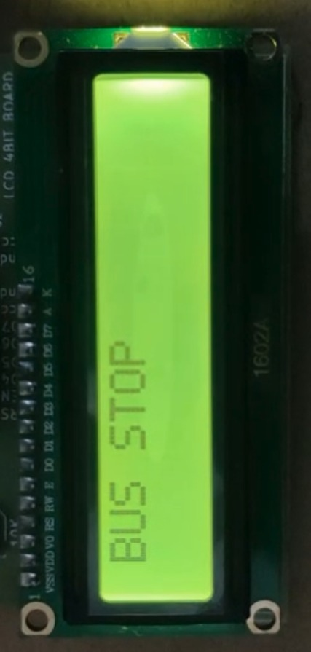
Bus Stop

Slide 32
Outcomes
ADVANTAGES:
Low cost Compact systems
Flexible to users
It takes less power to operate system
APPLICATIONS:
Gesture recognition and conversion.
As a translating device for Mute people.

Slide 33
Conclusion
Deaf and dumb individuals are dependent on sign language interpreters for communication. However, they cannot rely upon interpreters every day in life principally thanks to the high prices and also the problem in finding and hiring qualified interpreters. The impaired individuals use their normal sign language but that is not simple to understand for the normal people. This technique converts the gestures into voice that is definitely perceivable by the individuals. The sign language is translated into voice note, to facilitate the impaired people to convey their messages to others.

Slide 34
References
[1] Safayet Ahmed; Rafiqul Islam; Md. Saniat Rahman Zishaan; Md.Rabiul Hassan, “Electronics speaking system for speech impaired people”, May .2015.
[2] B.G.Lee, Member, IEEE, and S.M.Lee, “Smart wearable hand device for sign language interpretation system with sensor fusion”, Apr. 2017.
[3] Ghotkar, Archana S., “Hand Gesture Recognition for Indian Sign Language”, International Conference on Computer Communication and Informatics (ICCCI), 2012, pp 1-4.

Slide 35
References
[4] S. Vigneshwaran; M. Shifa Fathima; V. Vijay Sagar; R. Sree Arshika, "Hand Gesture Recognition and Voice Conversion System for Dump People,” IEEE International Conference on Intelligent and Advanced Systems, 2019.
[5] Jinsu Kunjumon; Rajesh Kannan Megalingam, "Hand Gesture Recognition System For Translating Indian Sign Language Into Text And Speech”, IEEE International Conference on Intelligent and Advanced Systems, 2019, pp 597-600.
[6] Byung-woo min, Ho-sub yoon, Jung soh, Takeshi ohashi and Toshiaki jima," Visual Recognition of Static/Dynamic Gesture: Gesture-Driven Editing System”, Journal of Visual Languages & Computing Volume10,Issue3, June 1999, pp 291-309.

Slide 36


